Slide 1
Database System for Managing Extensions, Late Penalties Waiver, and Deferrals
University Project Presentation
Group B: Adrian Sava, Alex Adams, Alexia Okeregbe, Jason Nicholls, Mai Anh Cao, Owen Kopp
22 May 2024

Slide 2
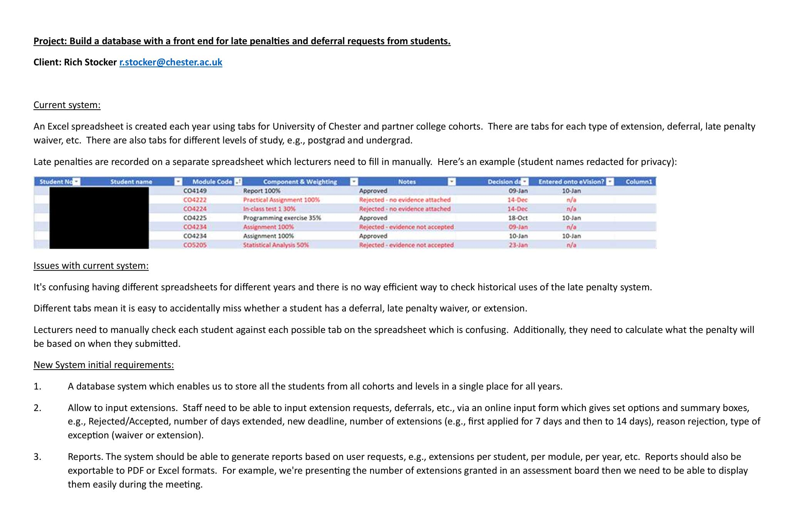
The Brief
Project Objectives
Build a system to manage student extensions, late penalties waivers, and deferrals efficiently
Key Features:
Centralized database for student data.
Online input forms for requests.
Report generation and export capabilities
Setting new deadlines for extensions
Options for request details and statuses

Slide 3
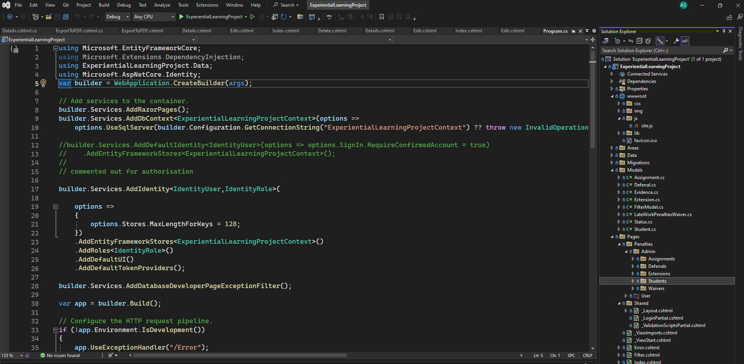
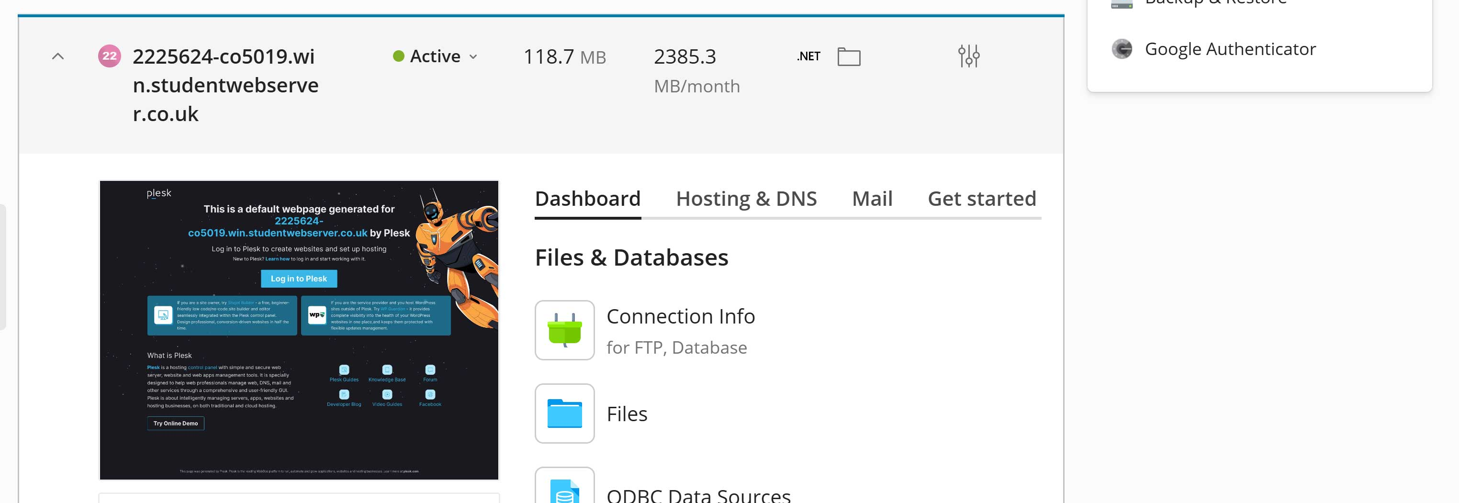
Technology
Technologies Used:
Backend: ASP.NET with Razor Pages, C#
Frontend:
HTML, CSS, JavaScript
Database:
Microsoft SQL Server Management Studio
Deployment:
Plesk

Slide 4
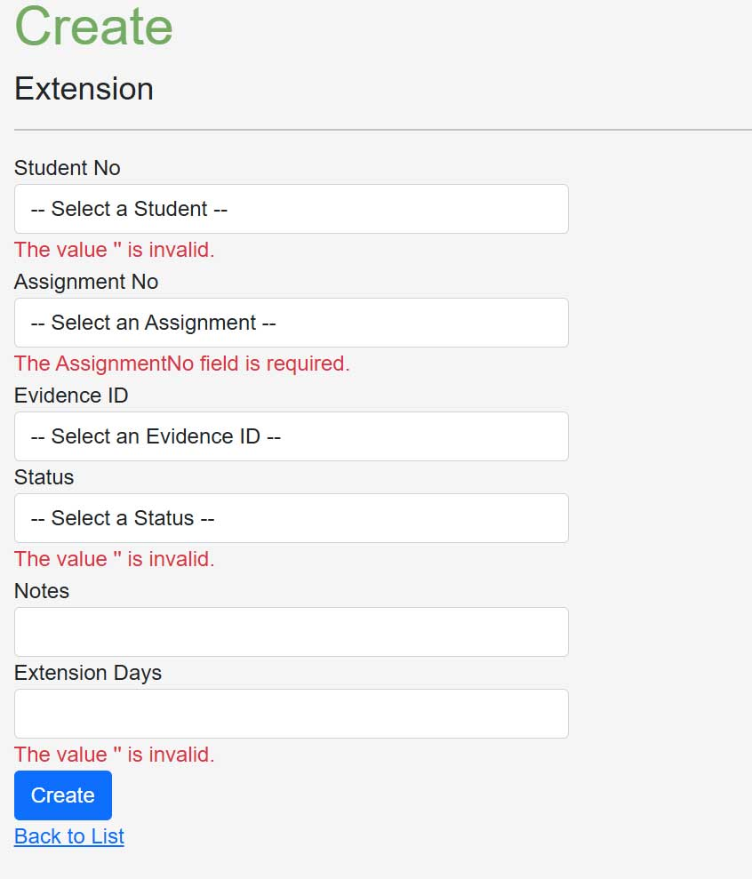
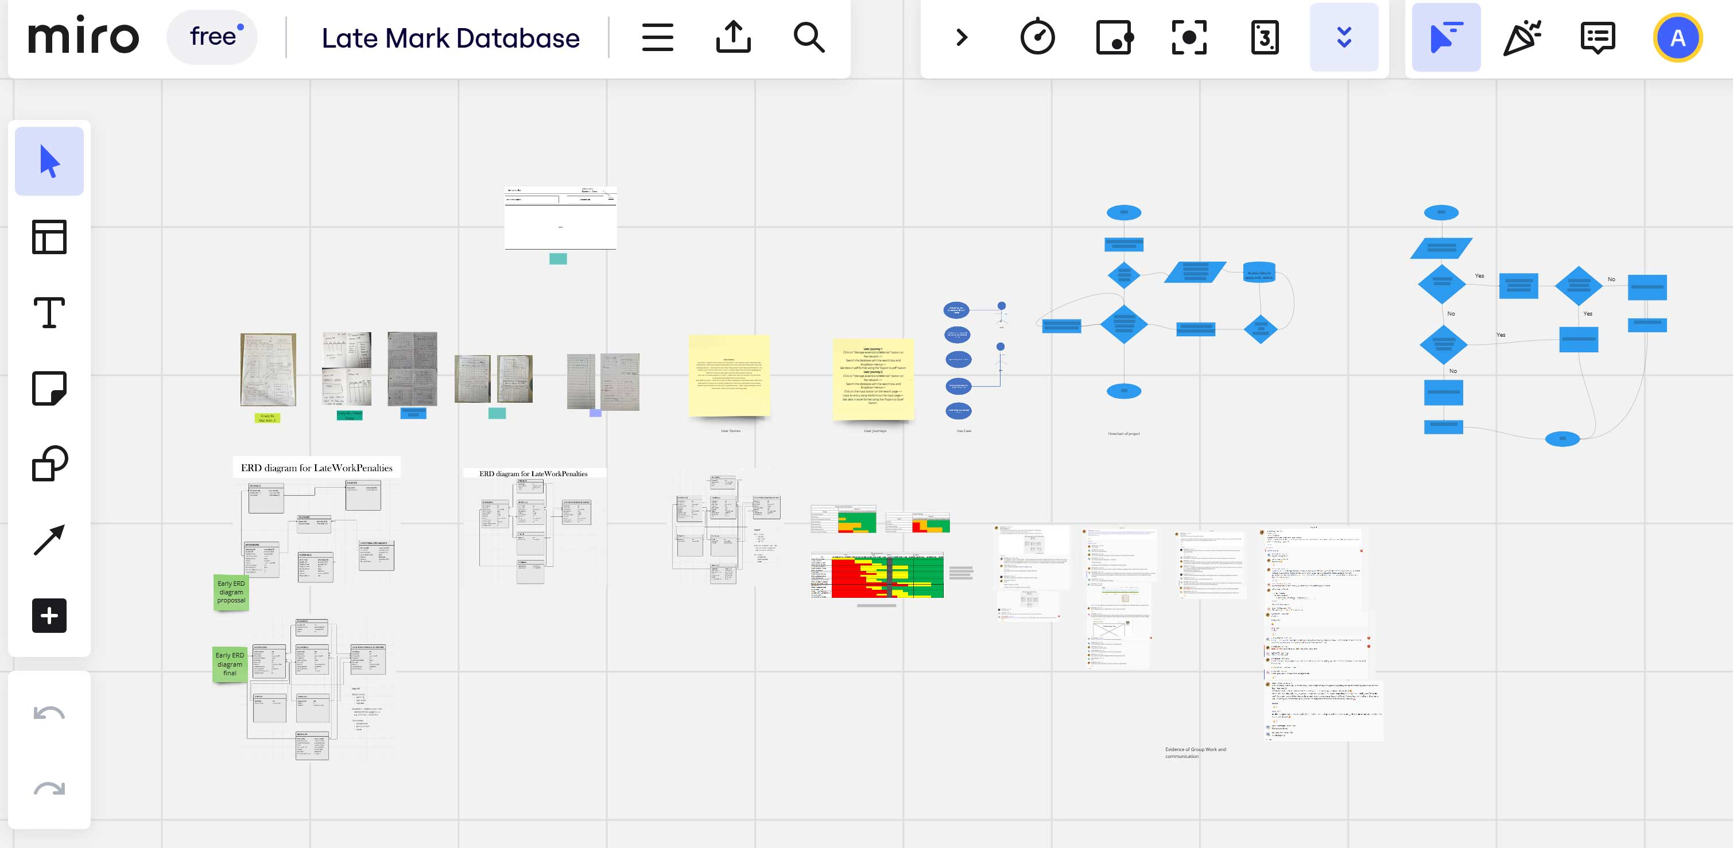
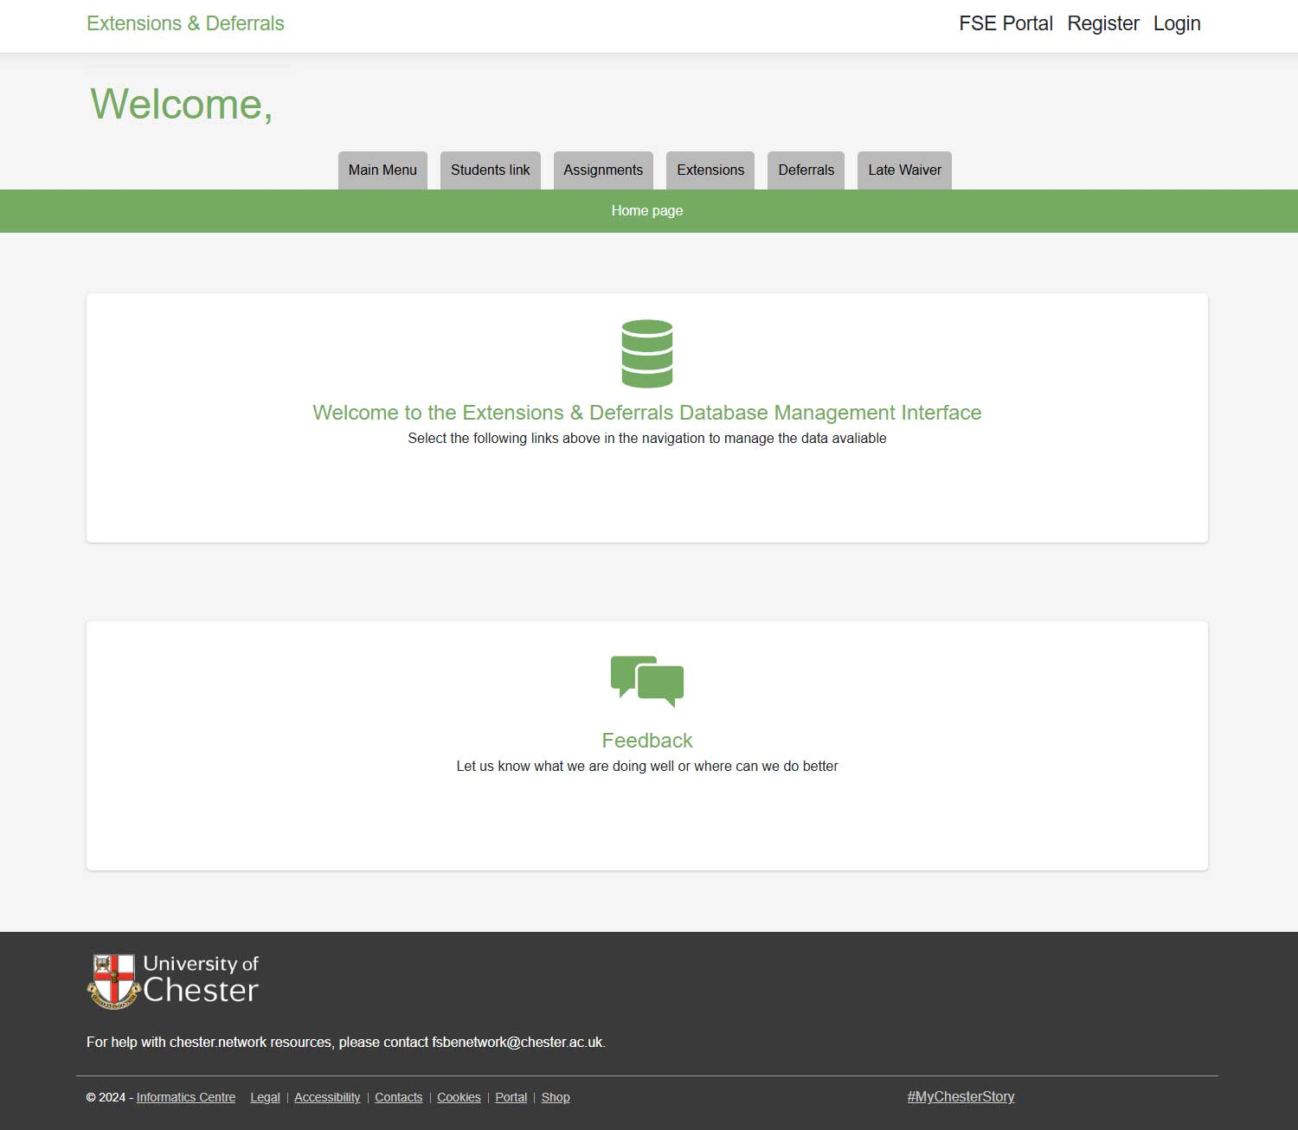
UI/UX and Design
UI
Resembling the existing chester.network system
WCAG criteria
User Journey & Crazy 8s for an intuitive design
UX
Online submission for easy management
Dynamic and criteria-based reports.
Export to PDF or Excel functionality

Slide 5
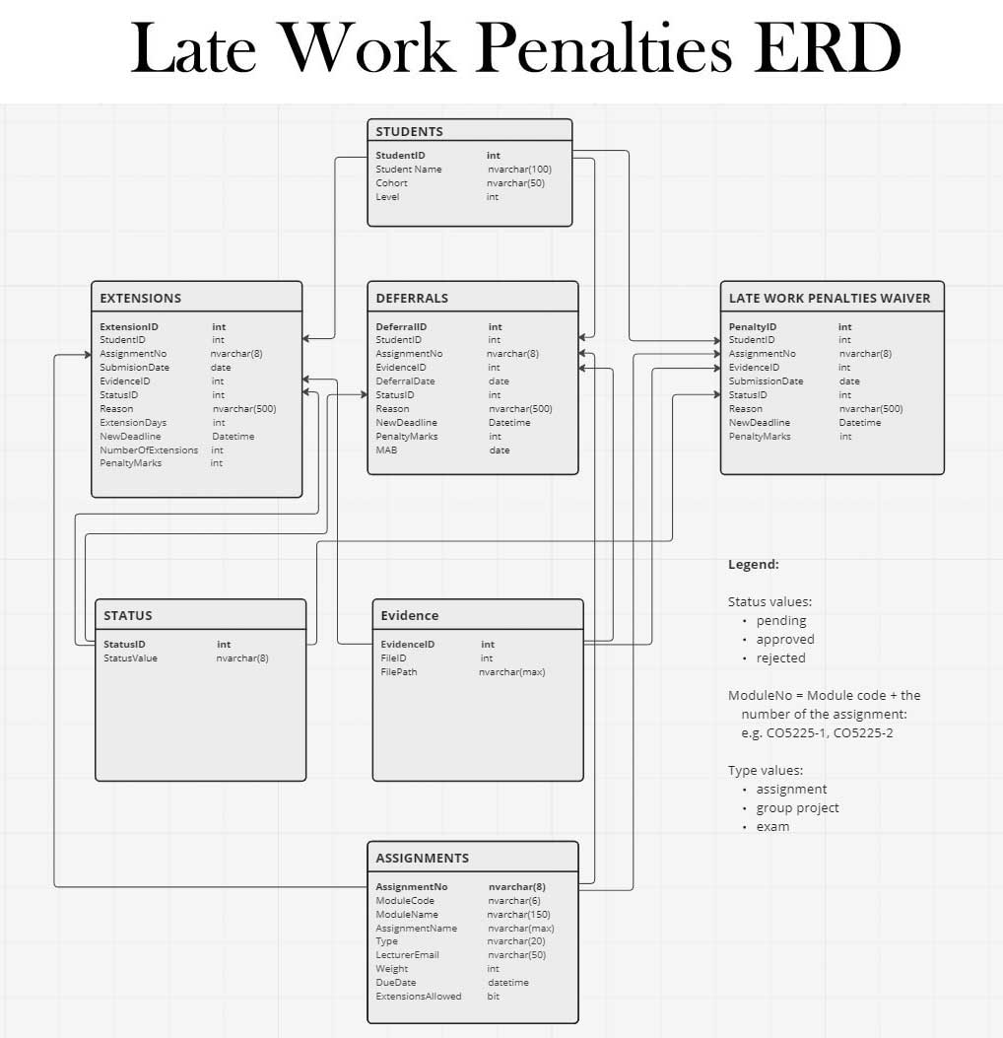
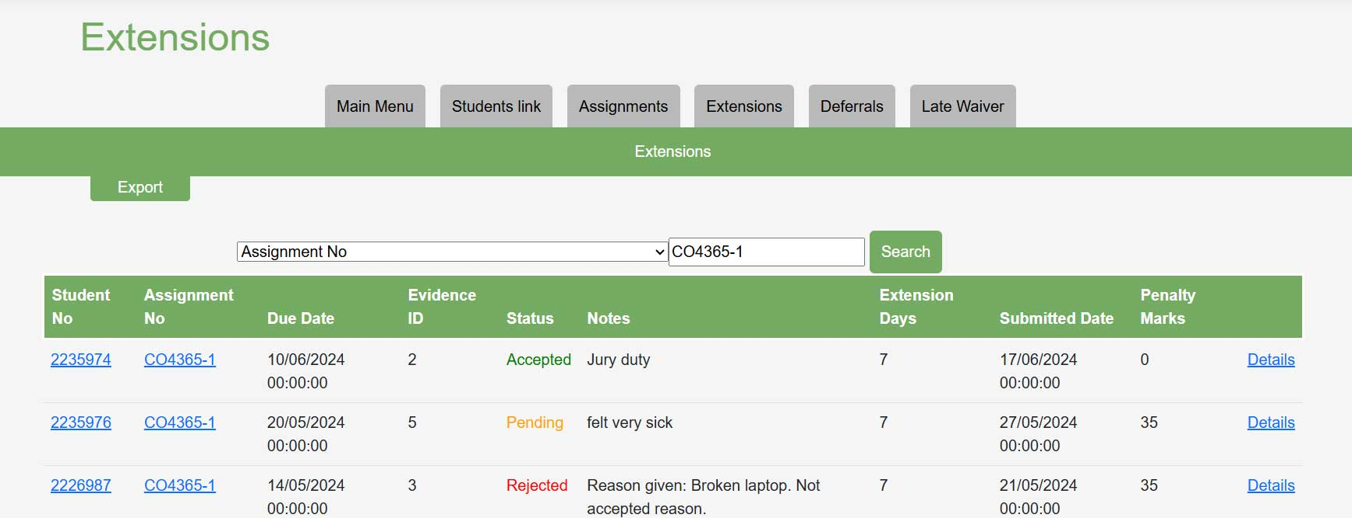
Database
Centralized Database:
Centralized student database across cohorts and levels
Filter database by different criteria (level, module, status, etc.)
Tables
Students
Assignments
Extensions
Deferrals
Waivers

Slide 6

Benefits and Impact
Improved Efficiency and Transparency
Reduced workload for staff by automating request processing
Increased efficiency, with a user-friendly online portal
Improved transparency with detailed reports
Image source: Pixabay.com

Slide 7

Conclusion and Q&A
Summary:​
Major objectives met, with key features implemented
Future Work:​
Additional request types and UI improvements​ - Historic usage per Student
- Export reports for individual Student, Assessment, Extension, etc.
- Other features, as requested by client
a
Questions

Slide 8
THE END
Thank you!

